Slide 1
Nervous System II:
Brain Structures

Slide 2
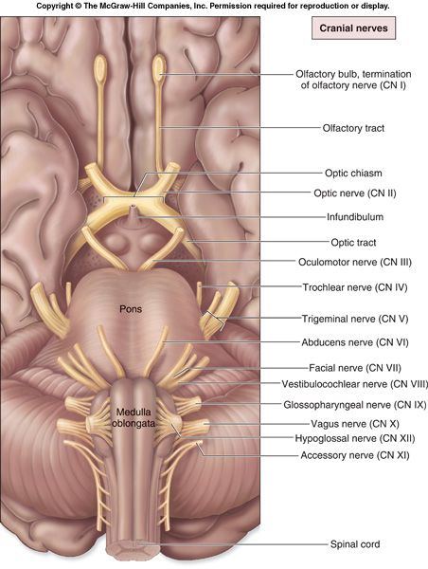

Slide 3
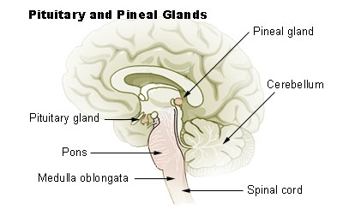
Pineal Gland
important in a person’s circadian rhythm (sleep-wake cycles)
secretes melatonin that promotes drowsiness
Seasonal affective disorder (SAD) – caused prolonged exposure to low light conditions that causes excessive secretion of melatonin

Slide 4
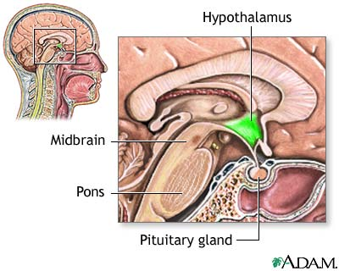
Hypothalamus
controls the autonomic nervous system
involved in the limbic system
controls body temperature
hunger-thirst center
produces hormones
  antidiurectic hormone (ADH) – causes the kidneys to conserve water and stimulates thirst when a person is dehydrated
  oxytocin – causes uterine contractions during childbirth

Slide 5
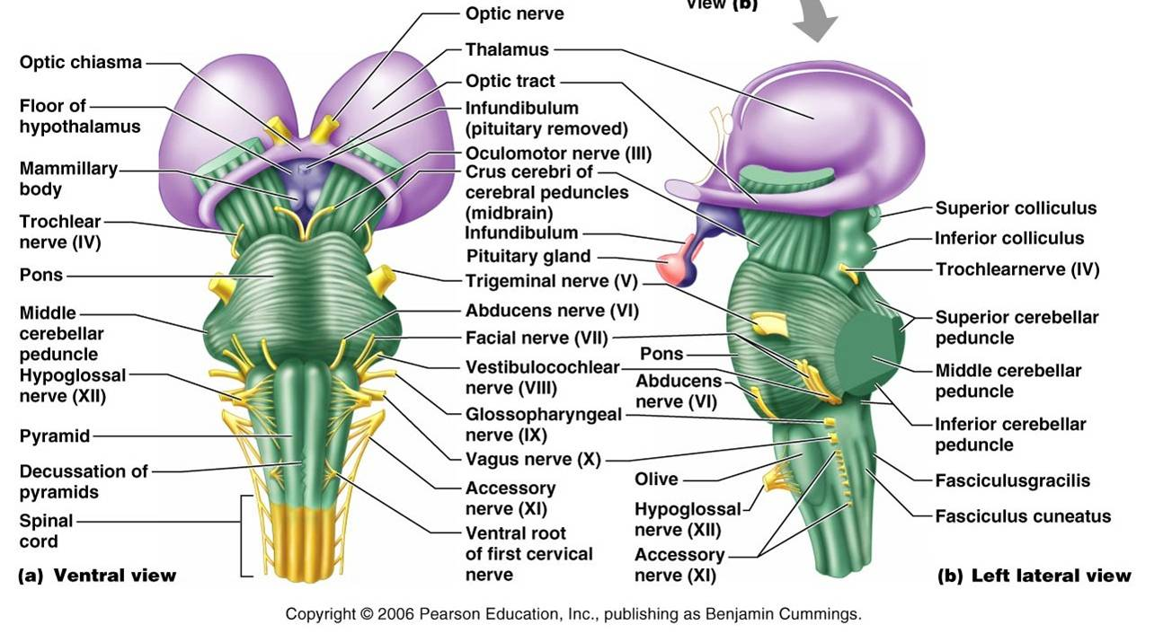
Midbrain

Slide 6
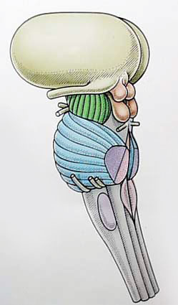
Midbrain: Corpora Quadrigemina
superior colliculi
corpora quadrigemina
inferior colliculi
superior colliculi – responsible for reflexive movements of the eyes and head in response to visual stimuli
inferior colliculi – responsible for reflexive movements of the head in response to sound stimuli

Slide 7
Medulla Oblongata
site of decussation – the crossing of the axons contained within the internal capsule
important control centers
  cardioregulatory center
  vasomotor center
  respiratory center
  deglutition center
  emetic center
reticular activating system – monitors sensory impulses, maintains consciousness, and is responsible for the arousal from sleep
medulla oblongata

Slide 8
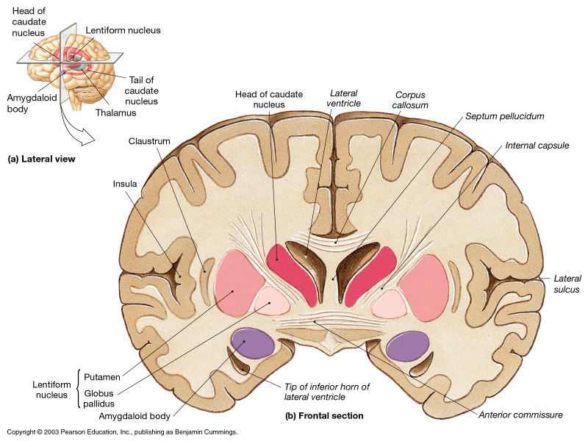
Basal Nuclei (aka Basal Ganglia)
send a continuous stream of motor impulses to skeletal muscles to generate muscle tone
affect semivoluntary muscle movement, such as arm swinging when walking

Slide 9
The Limbic System
controls a person’s attitude and feelings of stress, fear, happiness, pain, and pleasure
hypothalamus – center for circadian rhythm, sex drive, fear, pain, and pleasure
mammillary body – reflexes associated with smell
hippocampus – emotional reactions to remembered thoughts
amygdala – feelings of anger and rage

Slide 10
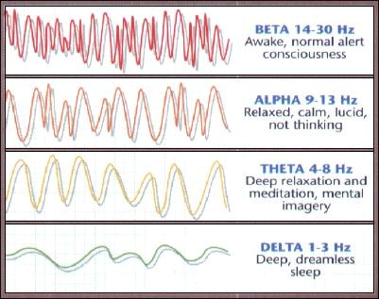
Brain Waves
when a person is conscious, thinking, and receiving sensory input
when a person has closed eyes but is not asleep
during times of emotional stress and in some brain abnormalities
during deep sleep

